Slide 1

Calming glitter bottles
SENSORY ACTIVITIES
BY TONI LEIGH

Slide 2
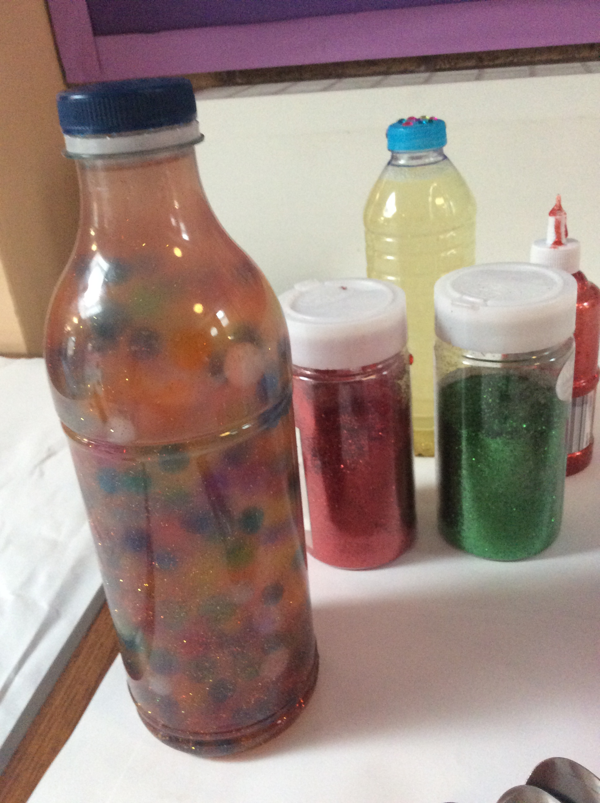
What you will need :
Plastic bottle or jar
Glitter glue
Glue or tape
Water
Added extras , buttons , pom poms, sequins, rice, water beads.

Slide 3
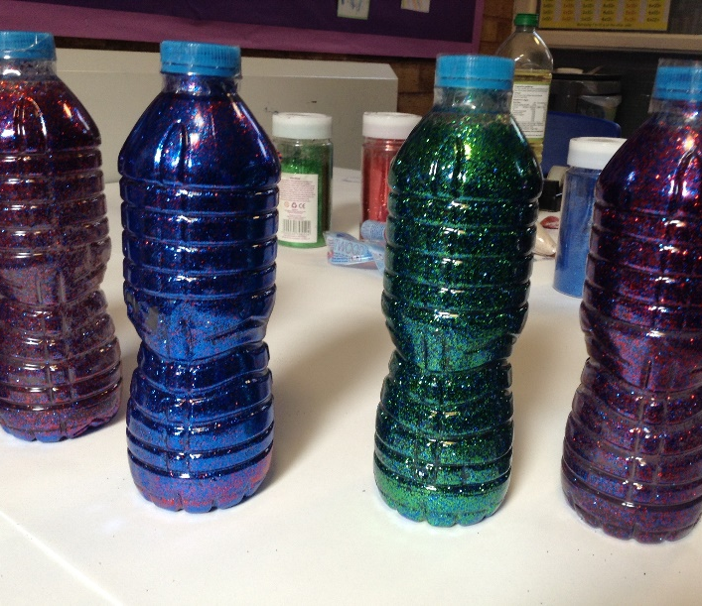
STEP ONE :
Firstly, you need to get your plastic bottle, make sure to have removed any labels from the bottle. This is so you will be able to see your calming bottle effect.
Once this is removed you need to add 3 quarters of cold water to your bottle.

Slide 4
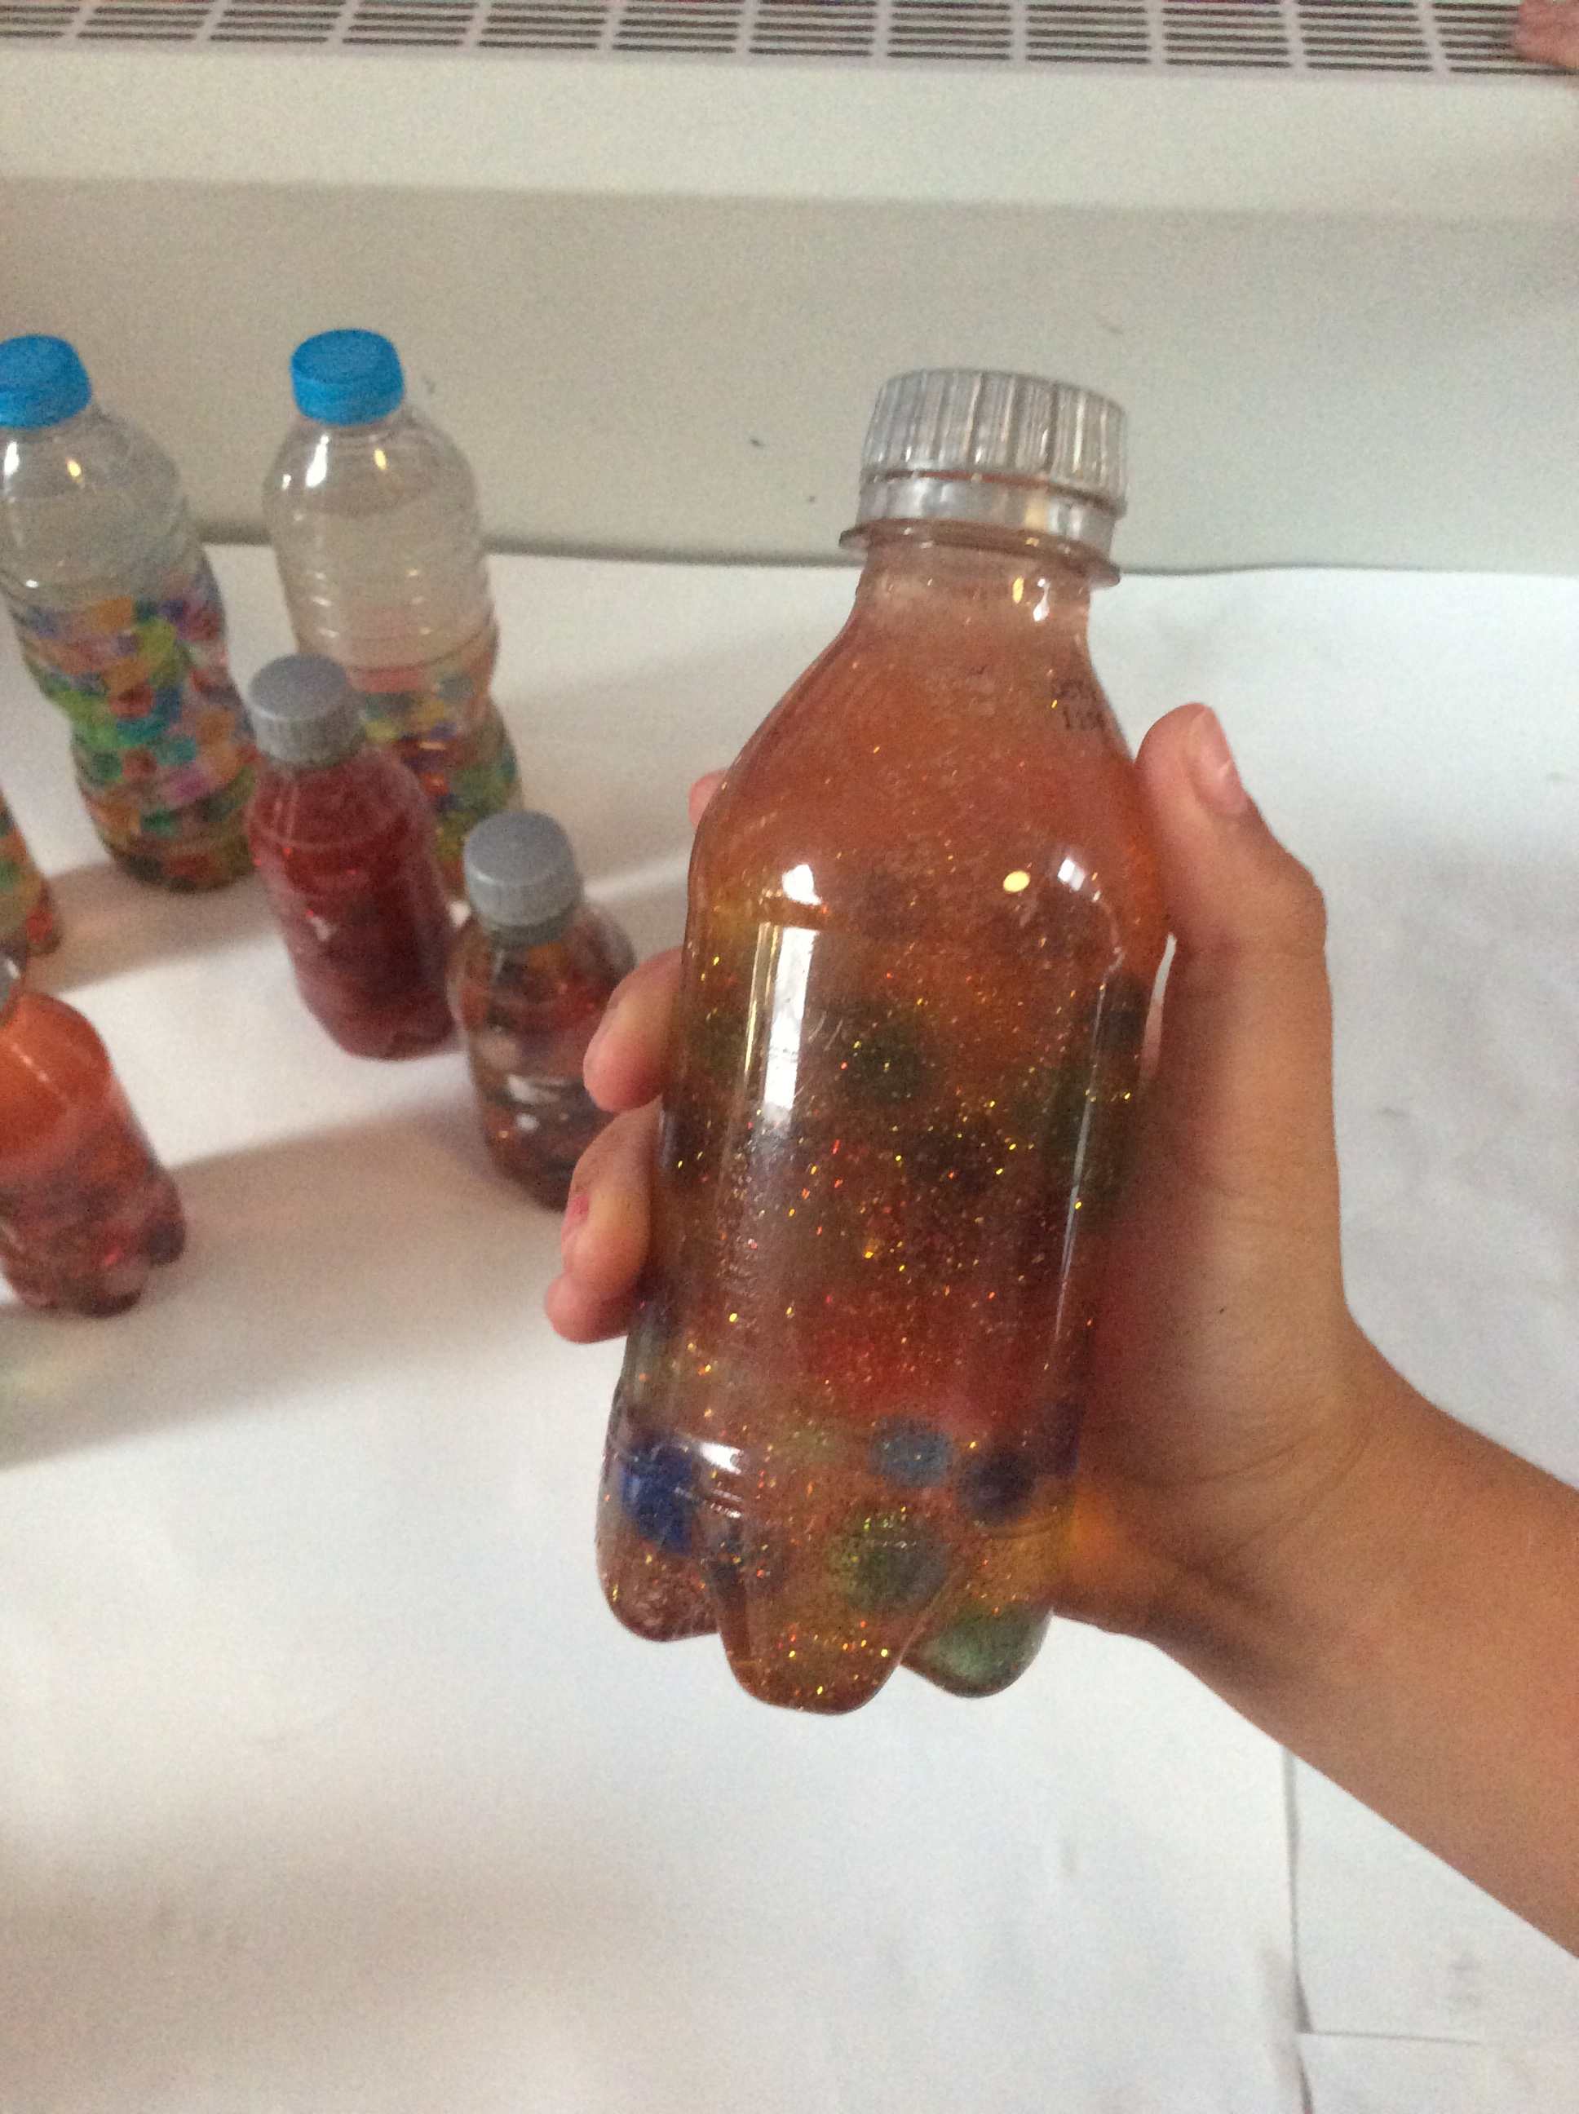
Step two :
Next add a generous amount of glitter glue. And then fill to the top with water.
Here secure the lid and give the bottle a shake to mix the colour into the water.

Slide 5
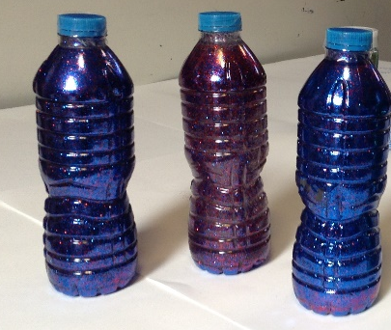
Step Five:
Now we need to secure the lid, so when the sensory bottle is shaken no water liquid leaks out .You can use any sort of tape, or you can use a glue gun to secure the lid. ( Adult )
You can add extras in like sequins or orbeez.
Hope you enjoy your calming sensory bottle. Don’t forget to tag us and share your pictures with us.

