Slide 1

Moon Sand
Sensory activities
By Toni Leigh
Copyright of Toni Leigh V.01

Slide 2
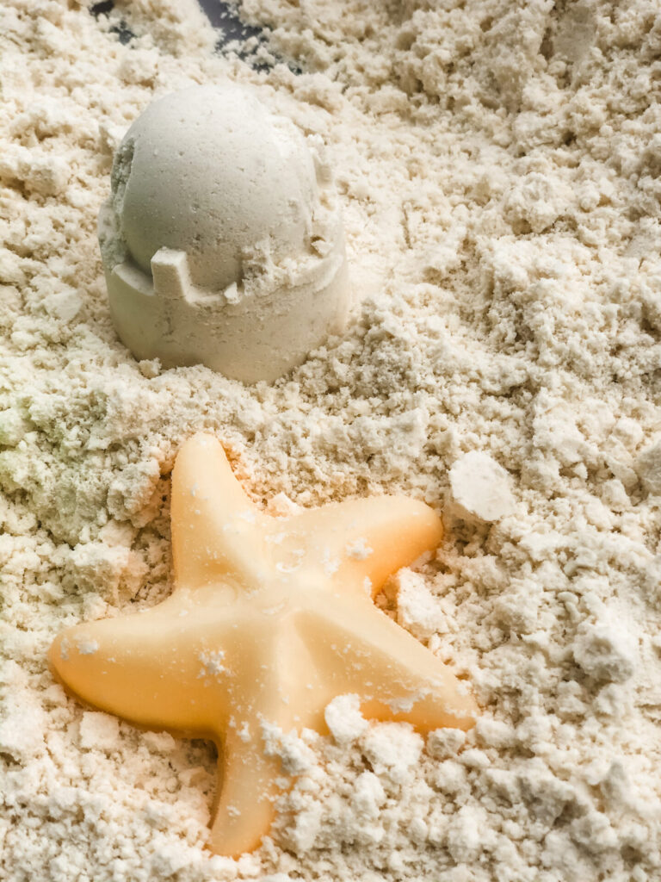
You will need:
4 Cups of flour
½ of baby oil or vegetable oil
Large tray or container
Optional’s
Food colouring, glitter, scoops, spoons, cutters, measuring cups, cars, trucks anything with aids play.
Copyright of Toni Leigh V.01

Slide 3
Step One
Firstly, Add 4 cups of flour to your container or tray
Then mix in ½ of baby oil or vegetable oil
Do this slowly and mix as you go along.
Copyright of Toni Leigh V.01

Slide 4
Step Two
Now mix well until the mixture is a crumbly texture and starts to stick together slightly like a kinetic sand.
Here we can add in added extras like our glitter, pom poms, buttons, trucks, cars etc..
Have fun exploring the new sensory texture! Don’t forget to share your photos with us!
Copyright of Toni Leigh V.01

