Slide 1
Octopus Windsock
Sensory activities
By Toni Leigh
Copyright Toni Leigh 2021 V.01

Slide 2
What you will need:
Windsock octopus
Paper plate
Scissors
Paint
Felt tips
Tissue paper
Optional – glitter, sequins, crayons, coloured card, pom poms, stickers.
-
Copyright Toni Leigh 2021 V.01

Slide 3
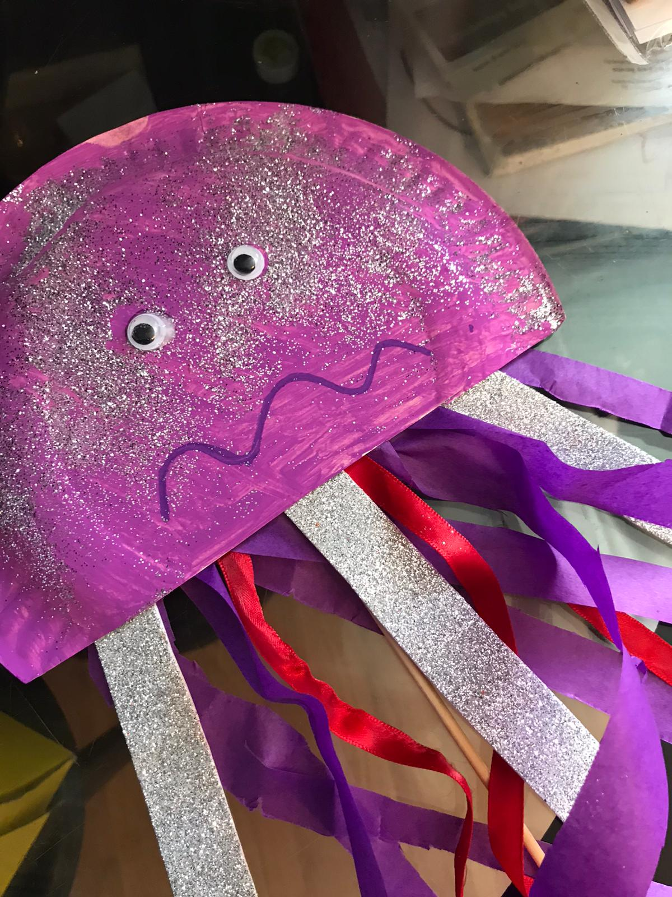
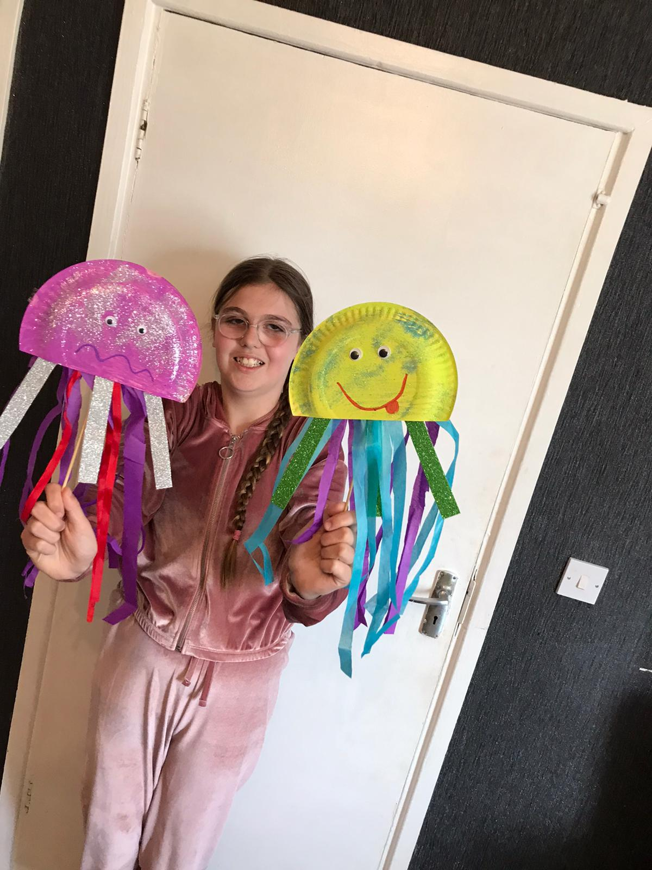
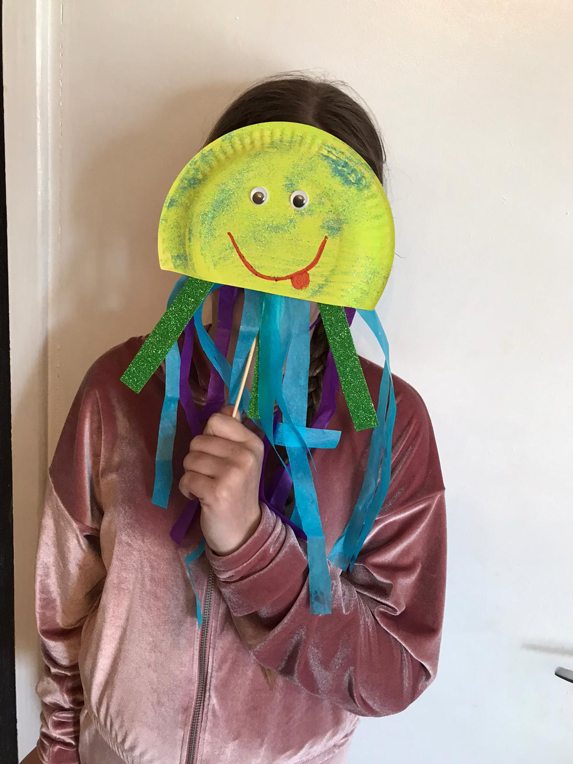
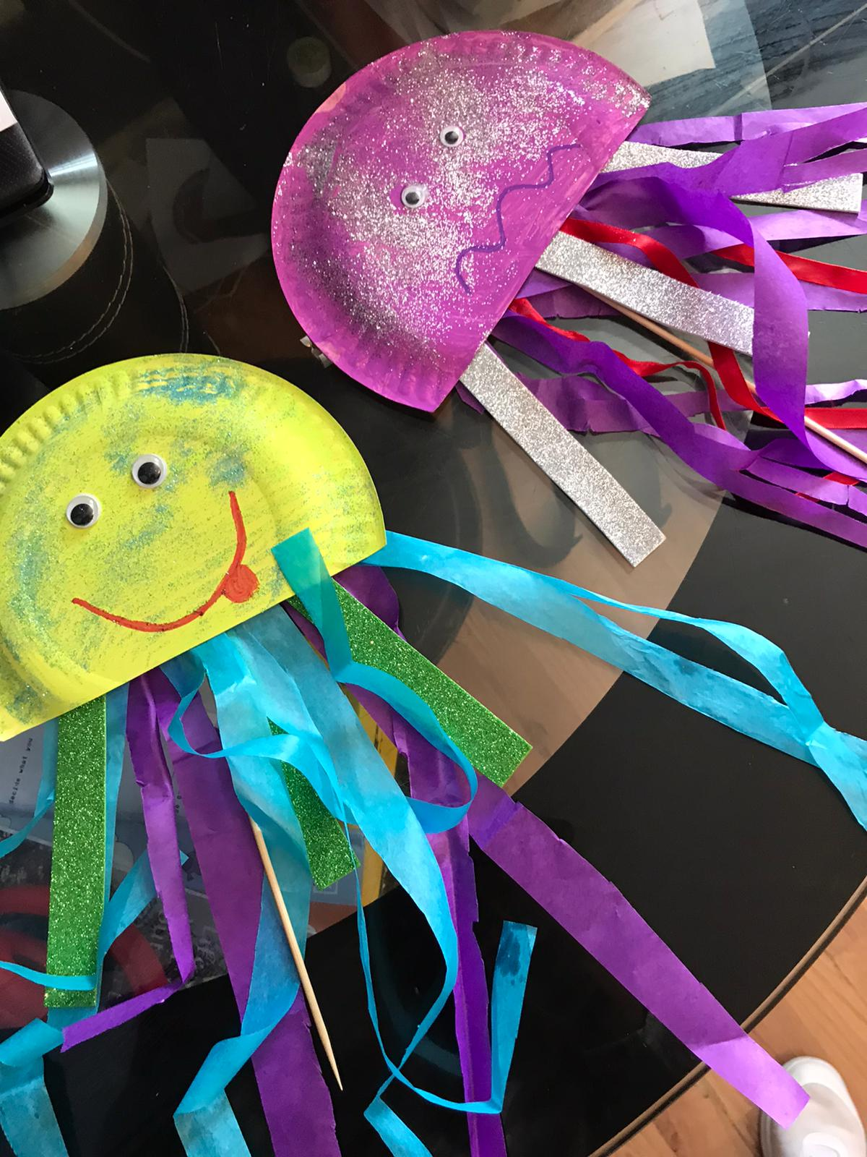
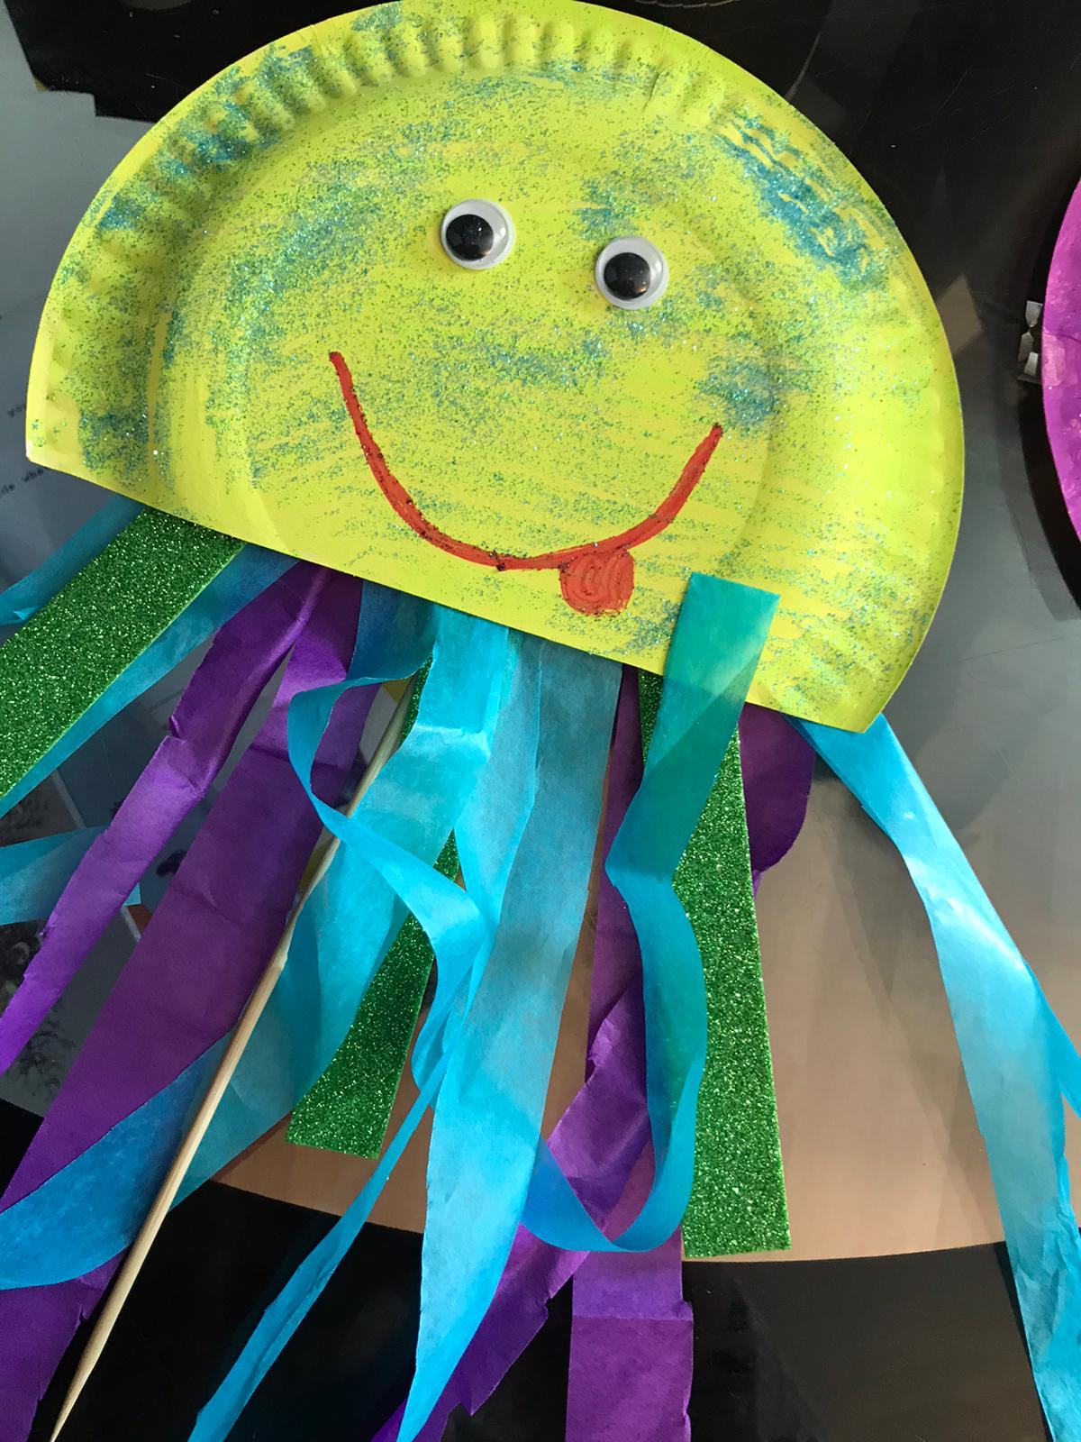
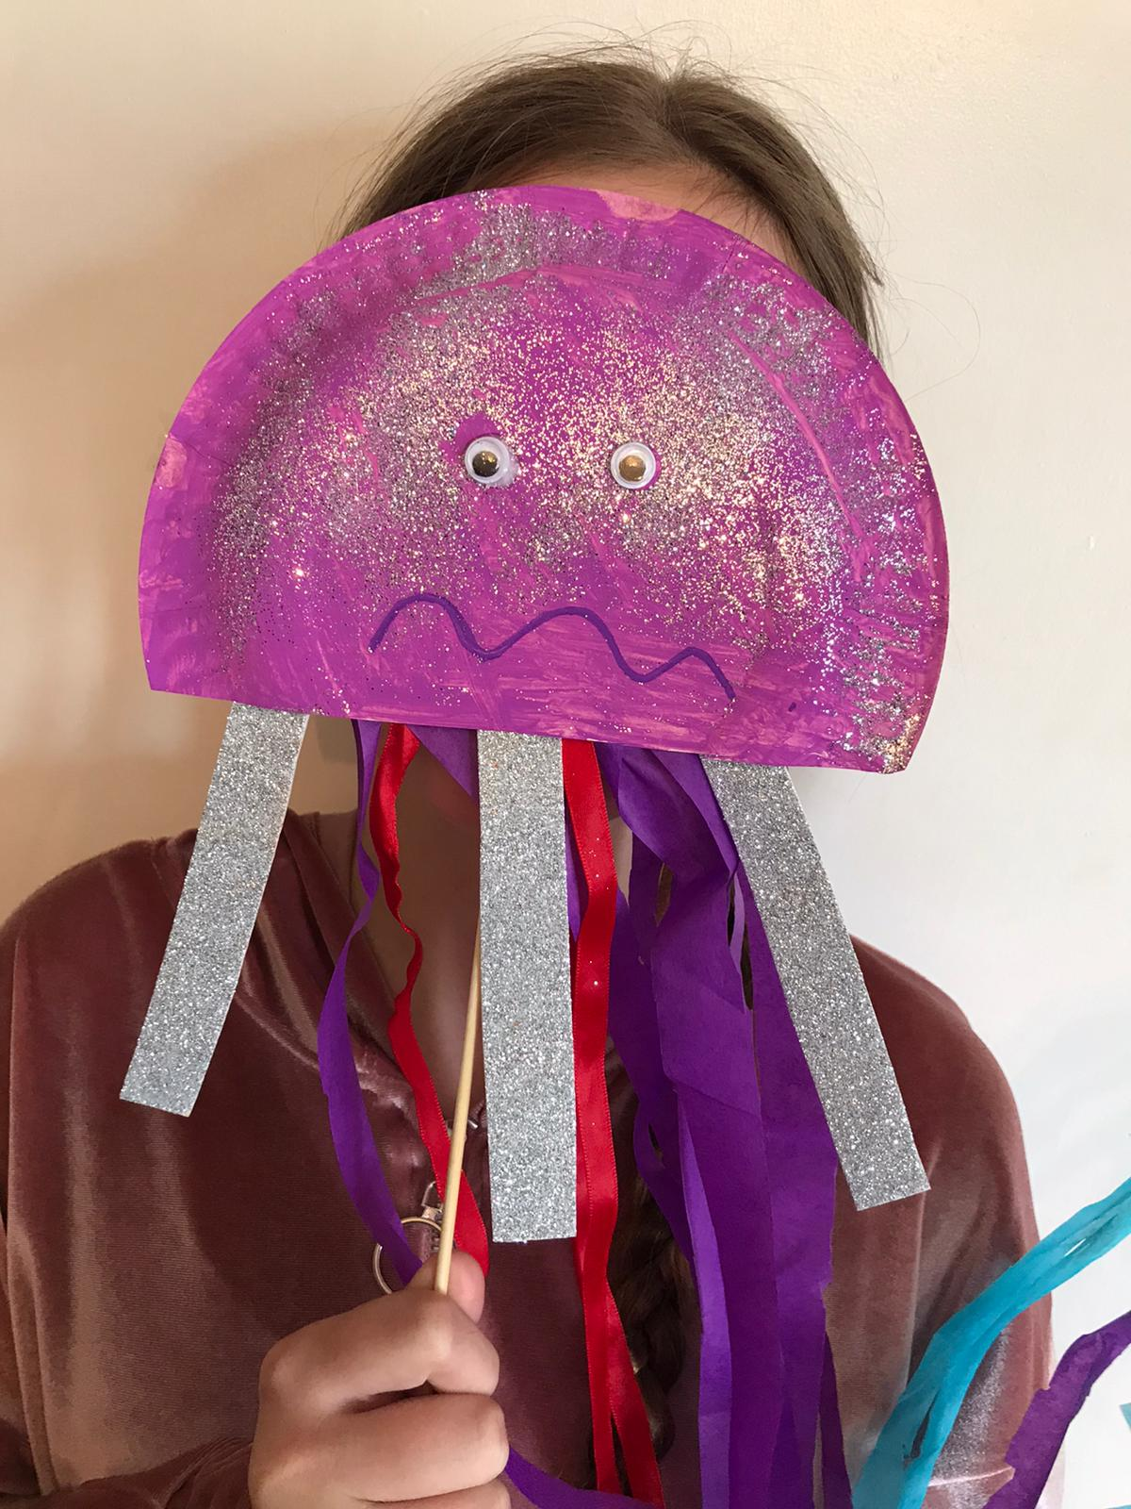
Firstly get your paper plate and cut it 3 quarters of the plate down. Secondly we need to paint the paper plate in the colour we wish with a paintbrush or a sponge and allow to dry.
Next get the tissue paper and cut into strips to hang from your octopus you can use other materials as well as tissue paper. Plastic bags , wool or string.
Glue them onto the bottom of your octopus.
I like to add some googly eyes onto my paper plate when its dry. You can make your face however you want using felts, crayons, sequins, pom poms make it as creative as you can.
Have fun making your octopus windsocks !!

