Slide 1
Coloured salt sensory play/jar
Parent and carers support group
Sensory activities
By Toni Leigh

Slide 2
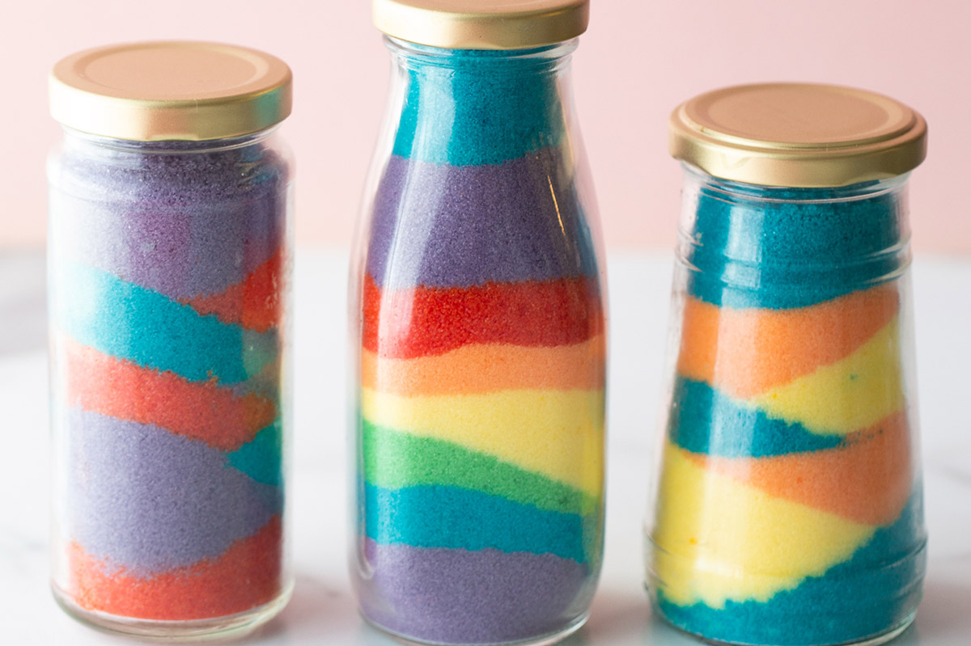
What you will need
Salt
Food colouring or paint
Zip lock food bags

Slide 3
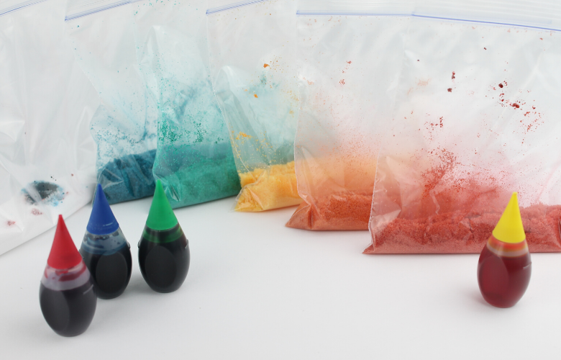
Step one
Begin by adding a cup of salt into a plastic bag. Repeat this step for different colours.

Slide 4
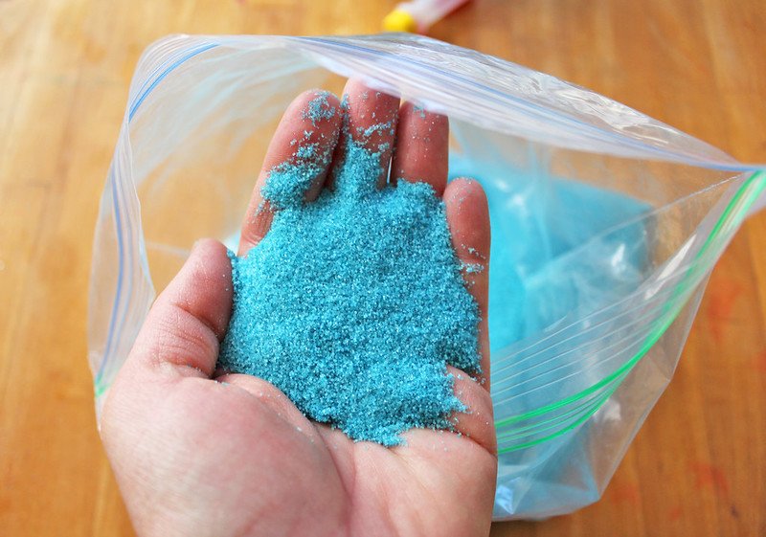
Step two
Here we need to now apply the food colouring to the Ziplock bag and then mix the salt and food colouring with your fingers by massaging the bag. Blend everything until you have coloured salt.

Slide 5
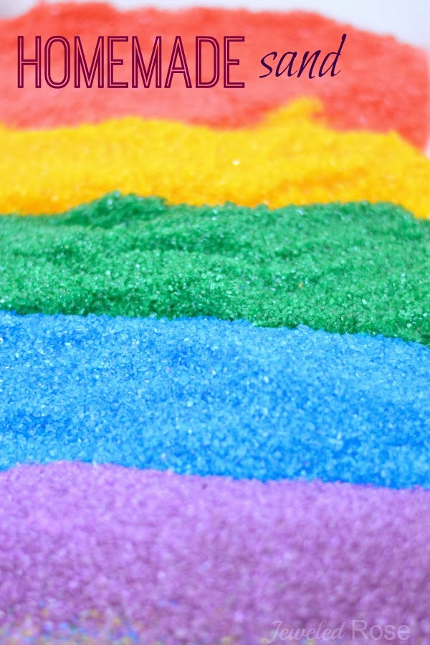
Step three
When you have mixed all the bags with coloured salt, open each bag and leave to dry If you want the salt to dry quickly spread it out on a flat surface. Once your salt is dry it is ready to be used for your sand jar or sensory play.
Have fun and don’t forget to share your pictures

