Slide 1
Shaving Foam Sensory Tray
Sensory activities
By Toni Leigh
Copyright Of Toni Leigh V.01

Slide 2


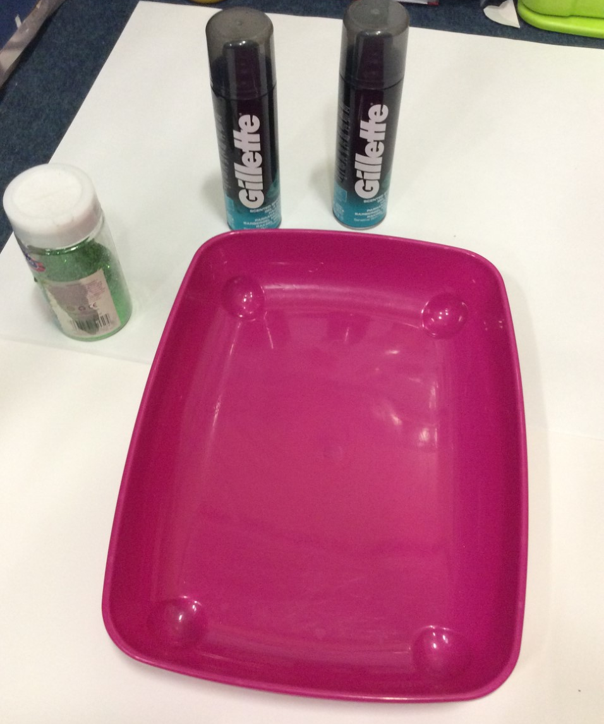



What you will need:
Shaving foam
Paint brush
Tray to put the mixture in
Food colouring
Glitter, essential oil, sequins, buttons, beads (optional)
Copyright of Toni Leigh V.01

Slide 3
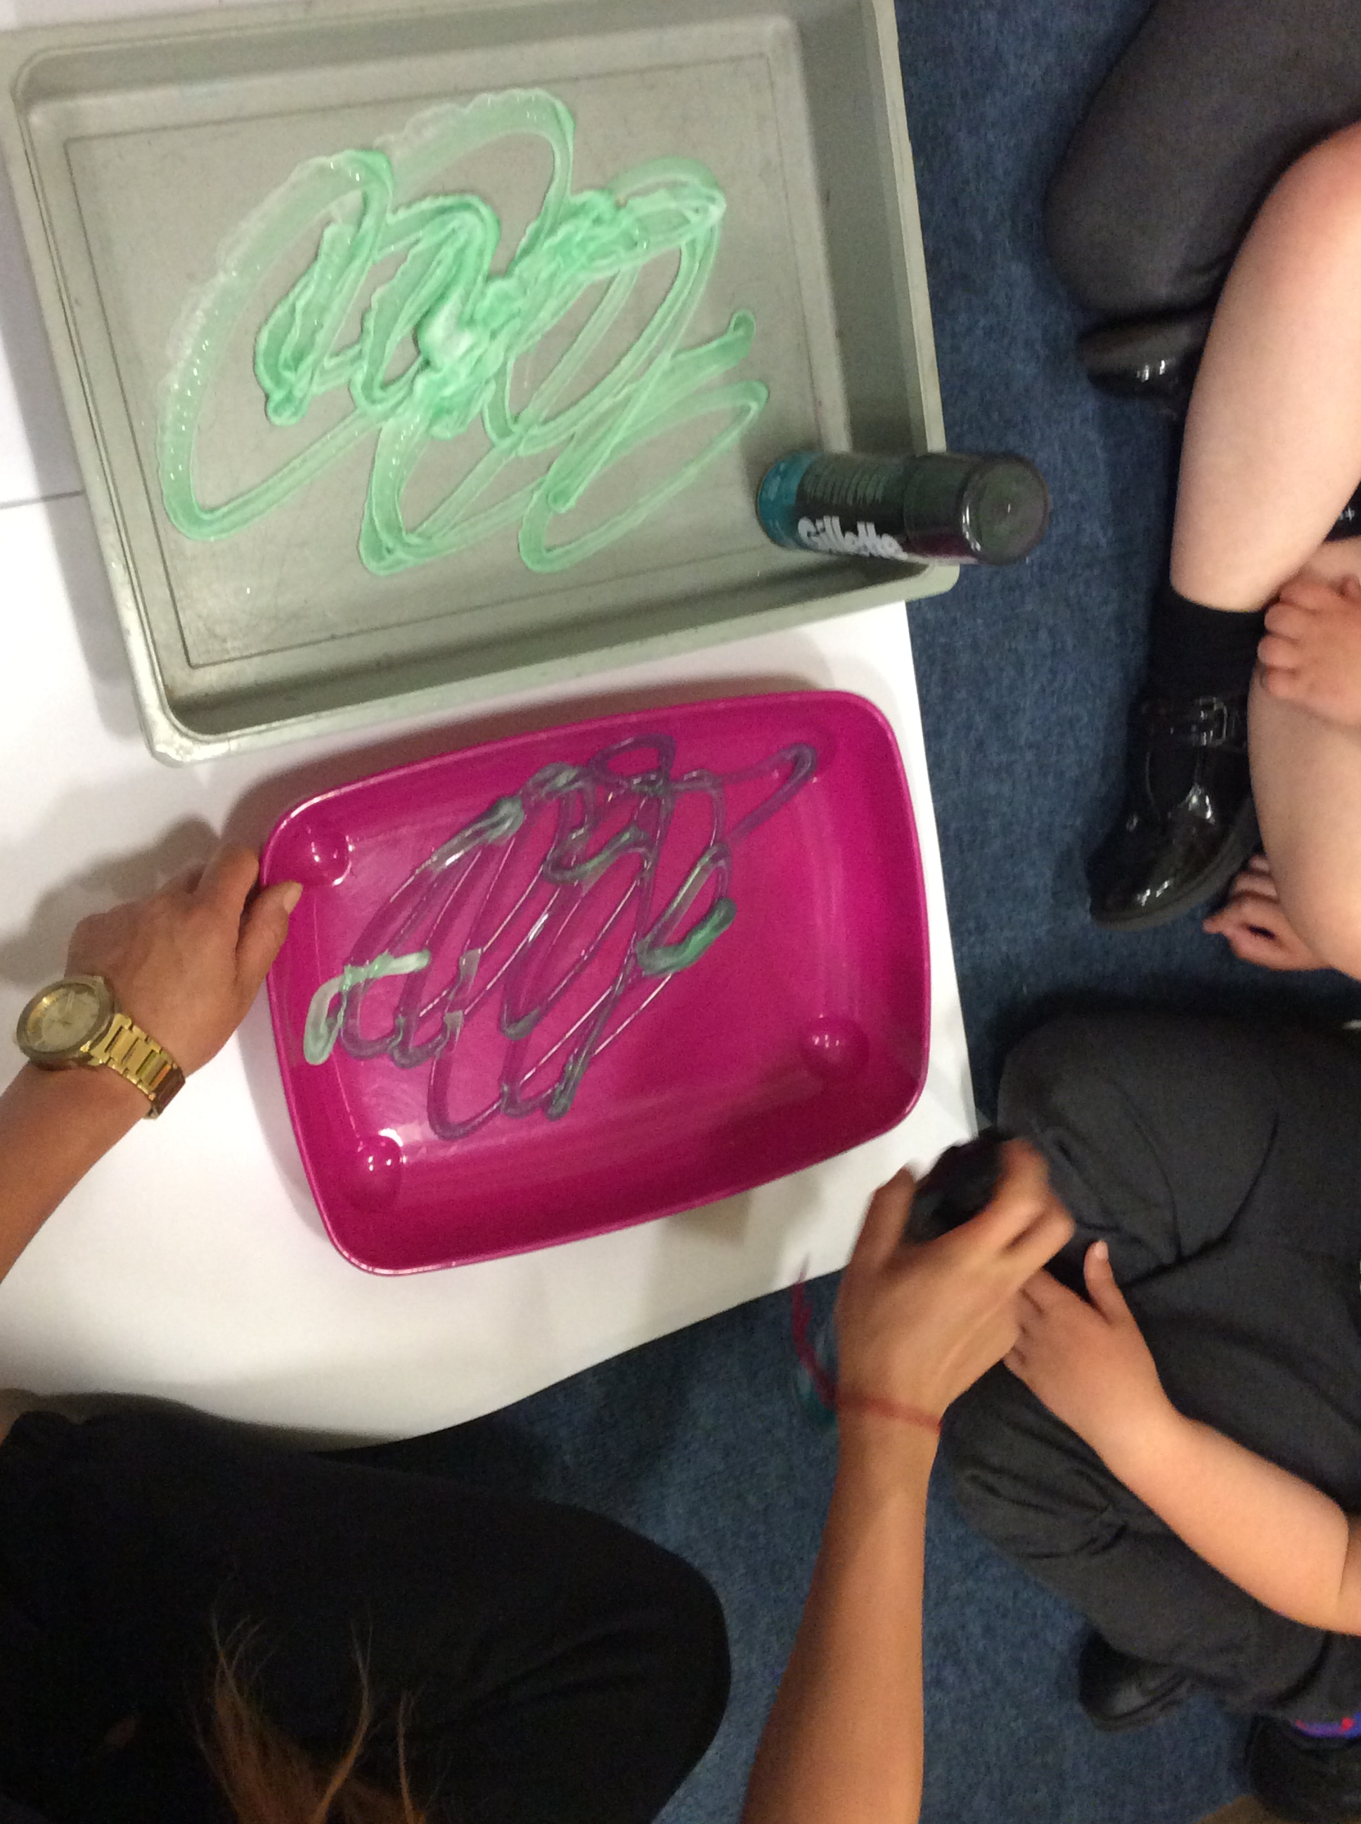
Step One
Firstly, we need to add our shaving foam to the tray, bowl or chosen mixing appliance. Depending on how you have chosen for your children to explore the foam texture as this can be by hands or feet. Something I like to put down is a large piece of tarpaulin. If you don’t wish to get the mess inside your house, you can always lay this out in the garden for the children.
Copyright of Toni Leigh V.01

Slide 4
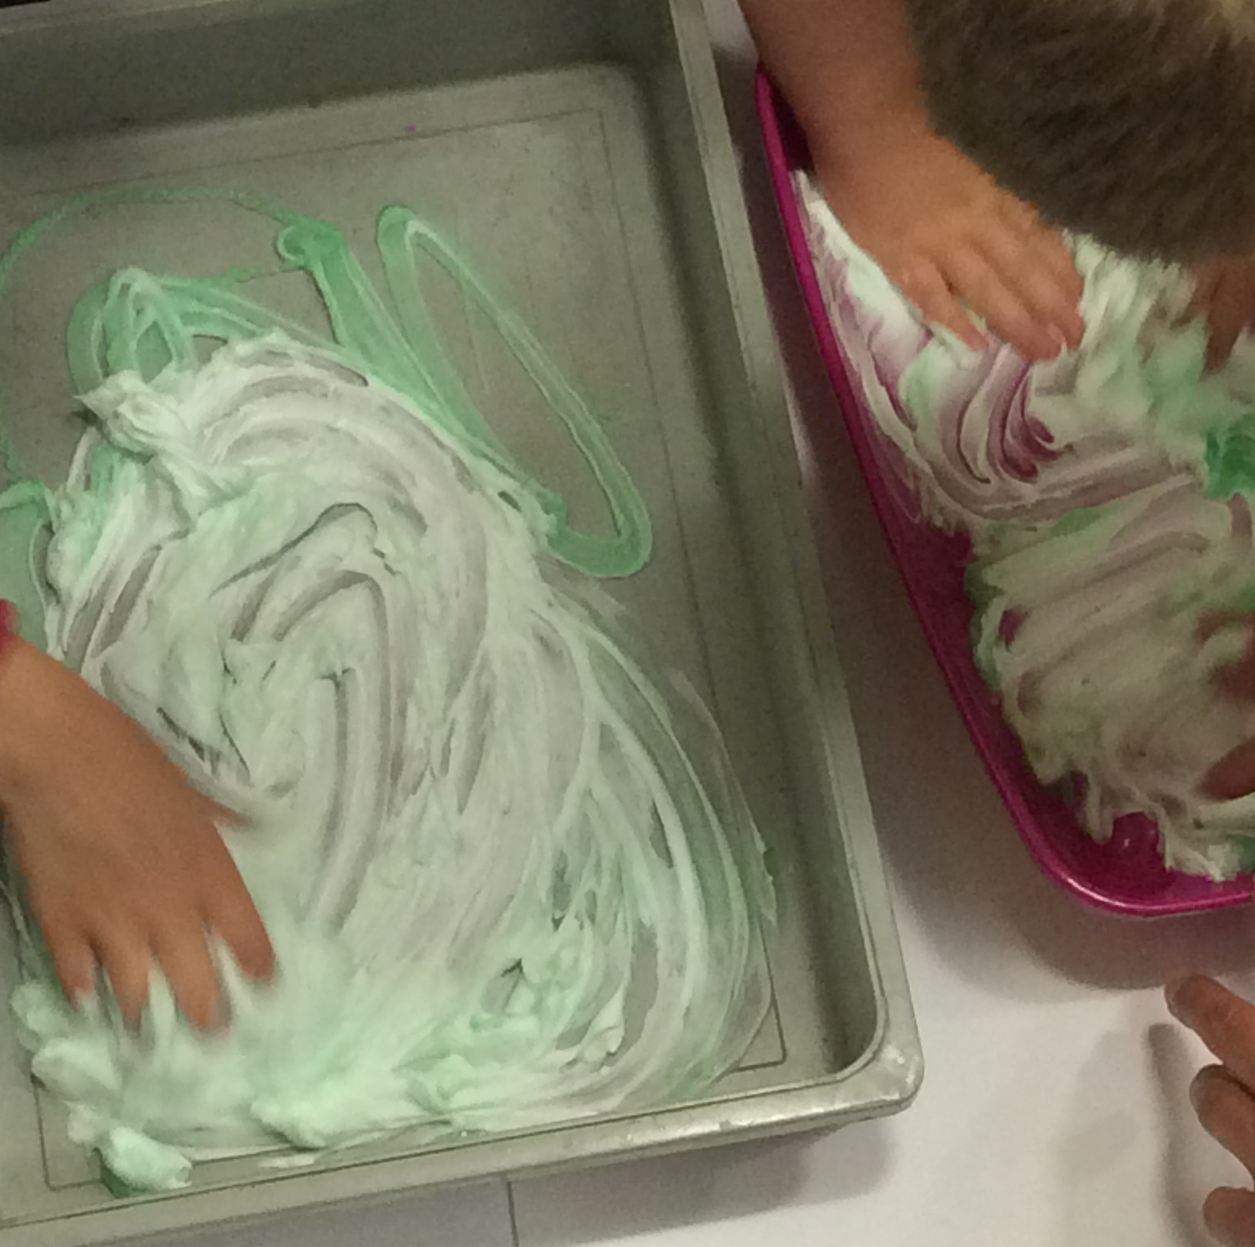
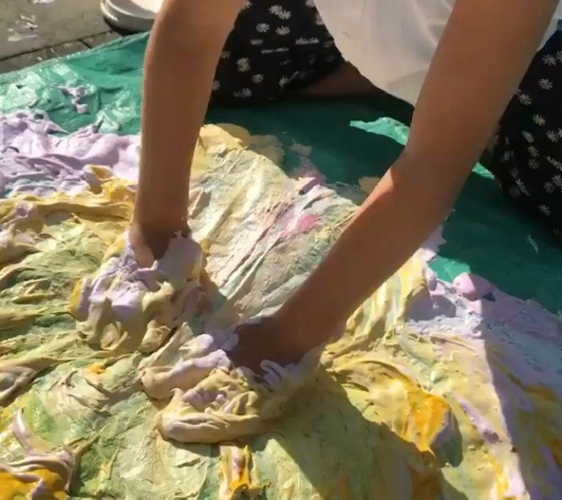
Step Two
Once you have added the shaving foam to the mixing appliance you can now add in the extras.
If you are using food colouring only add approx 2/3 drops to the foam.
You can add in glitter, pom poms, sequins anything you want to use that is safe to do so.
I personally like to add in an essential oil to give the foam a scent. I like to add lavender to create a calming effect.
Copyright of Toni Leigh V.01

Slide 5
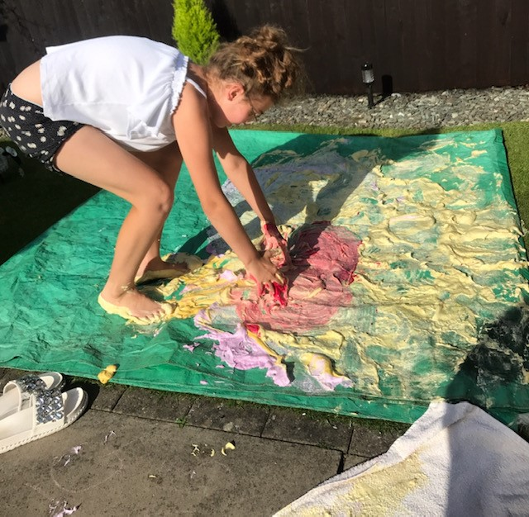
Step Three
This is where the fun starts.
Mix in all the ingredients into the foam with your hands or feet.
Let THE CHILDREN EXPLORE THE NEW TEXTURES.
Enjoy and have lots of fun !!
Copyright of Toni Leigh V.01

